Slide 1
PROJECT TITLE : MENTAL HEALTH AWARENESS WEBSITE
GUIDE NAME :
MR.S.GIRINATH
Assistant professor
Computer Science Engineering
Narayana Engineering college
TEAM MEMBERS :
19711A0566 – NALLIBOINA RAMYA
19711A0591 – SHAIK ANMOL
19711A0576 – PIGILAM BHARGAVI
19711A05A8 – THALUCHURI MONIKA TANMAI
18711A0533 – MUSALI YESHASWI

Slide 2

OVERVIEW
ABSTRACT
SOCIAL RELEVANCE
FUNCTIONAL REQUIREMENTS
SOFTWARE AND HARDWARE REQUIREMENTS

Slide 3
ABSTRACT
To create a website within which users can access resources to educate themselves, help themselves, others and spread awareness on mental health.
The goal for this project was to create a single website where users with different needs can retrieve information on mental health without having to shift through multiple webpages.
On our website, users can easily navigate across different pages to find the information within the area of mental health and mental health awareness.

Slide 4
SOCIAL RELEVANCE
Mental illnesses affect 19% of adult population, 46% of teenagers,13% of children each year.
Help you to understand mental health condition symptoms, find professional treatment.
Break the mental health stigma that helps so many people suffering in secret.
The need for mental health treatment, more mental health resources will become available.

Slide 5
FUNCTIONAL REQUIREMENTS
Users can share their stories
Users can find information of available mental health services.
Users can see notifications of exercises, campaigns on mental health.
Users can search for Yoga centres.

Slide 6
SOFTWARE AND HARDWARE REQUIREMENTS
Software requirements :
Operating System: windows 10
Cloud services : Amazon Web Services(aws)
Front end languages : HTML ,CSS ,JS
Backend languages : Php
Database: MySQL
Editors : Visual Studio Code
Hardware requirements :
Processor – i3,8th gen or above
Storage – 35 GB
Memory – 4GB RAM

Slide 7
DESIGN PHASE
Web Pages
UML Diagrams
Use Case Diagrams
Class Diagrams
Activity Diagrams
Sequence Diagrams

Slide 8
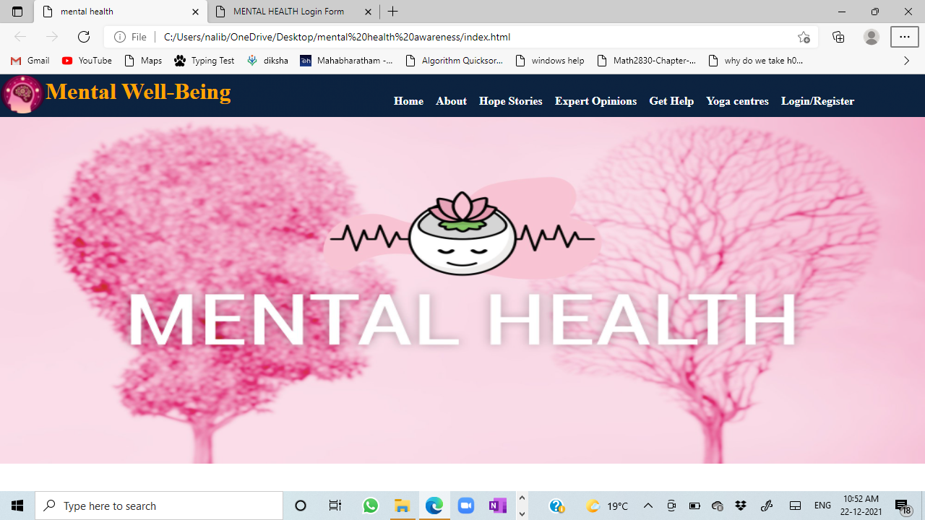

Slide 9
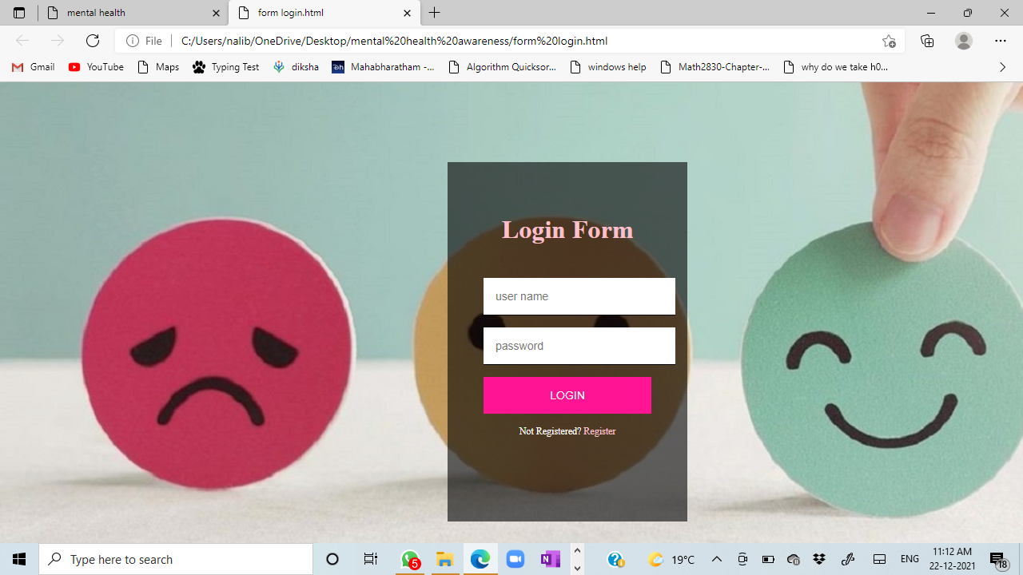

Slide 10
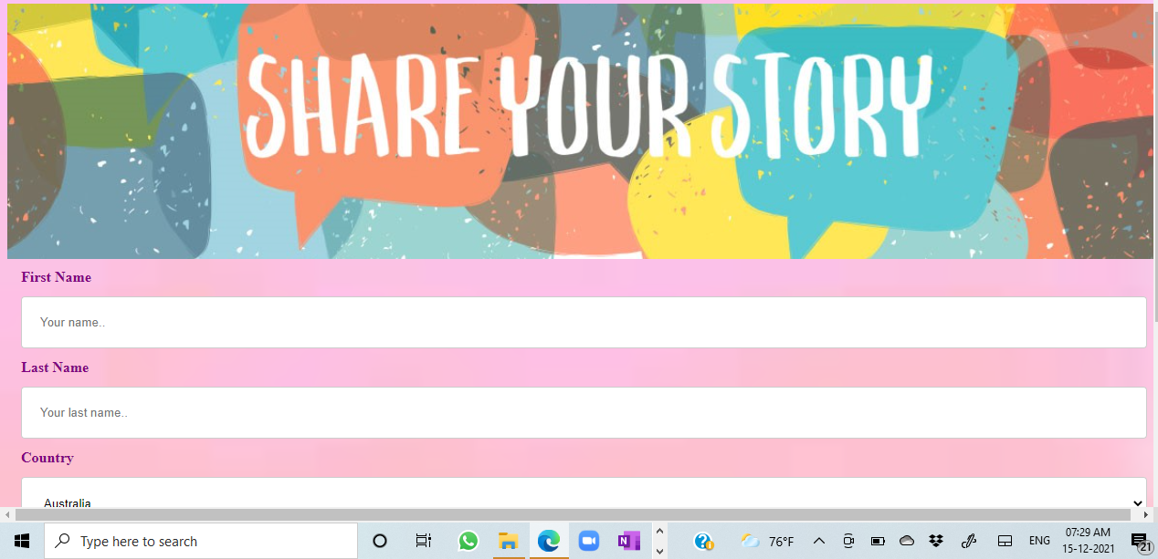
Share Stories Form

Slide 11
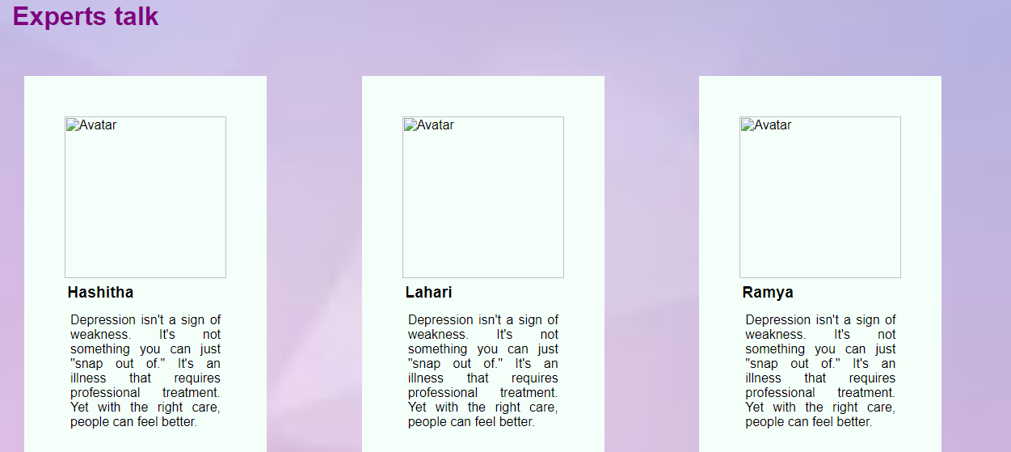
Experts advice page

Slide 12
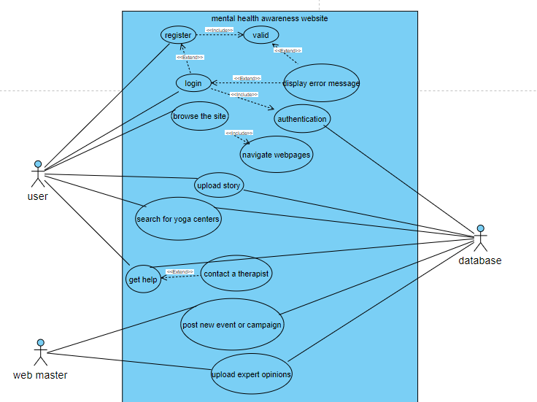
Use case diagram

Slide 13
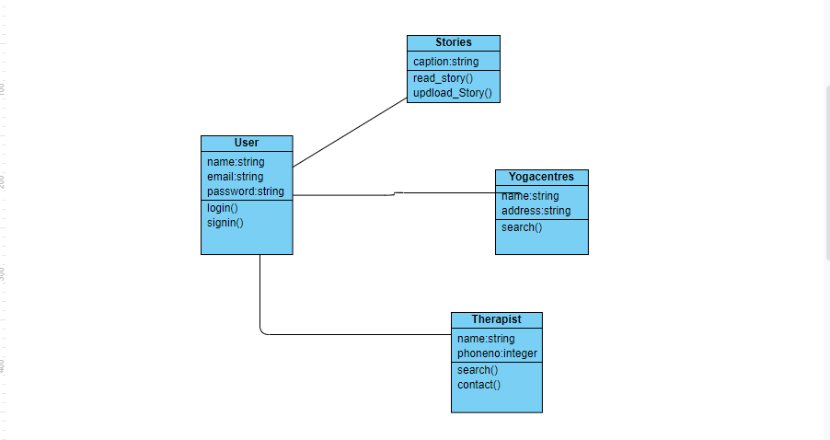
Class diagram

Slide 14
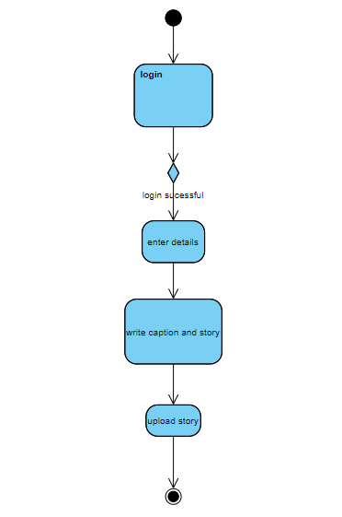
Activity diagram

Slide 15
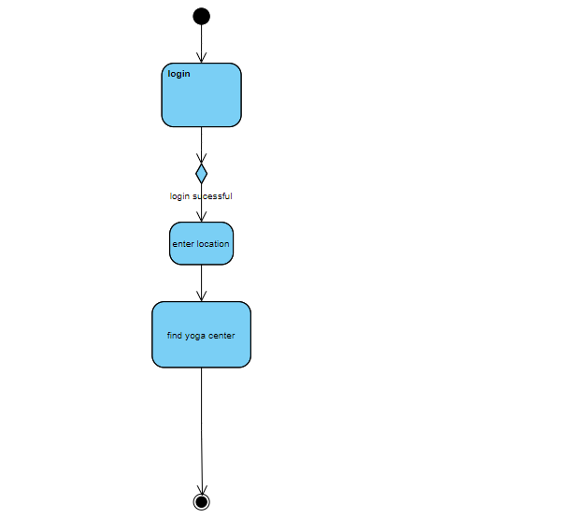
Activity diagram

Slide 16
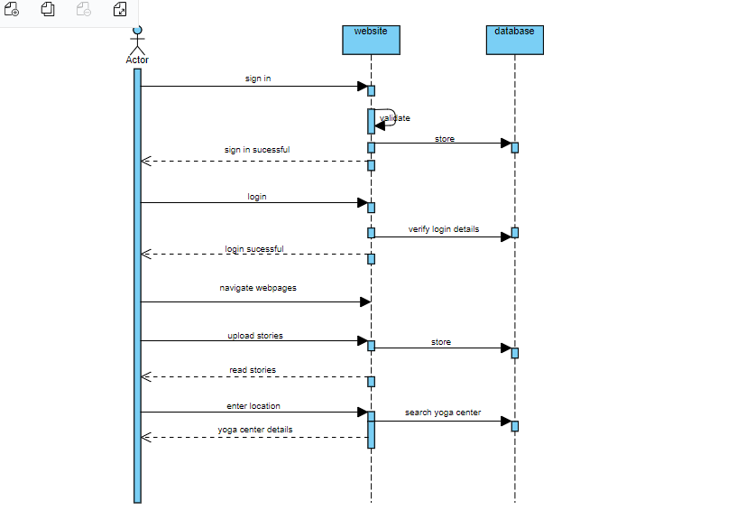
Sequence diagram

Slide 17

Thank you

